Slide 1
Decision Trees

Slide 2
Entropy
In thermodynamics, entropy is a measure of how ordered or disordered a system is.
In information theory, entropy is a measure of how certain or uncertain the value of a random variable is (or will be).
Varying degrees of randomness, depending on the number of possible values and the total size of the set.

Slide 3

Shannon Entropy
Introduced by Claude Shannon in 1948
Quantifies “randomness”
Lower value implies less uncertainty
Higher value implies more uncertainty

Slide 4
Information Gain
Uses Shannon Entropy
IG calculates effective change in entropy after making a decision based on the value of an attribute.
For decision trees, it’s ideal to base decisions on the attribute that provides the largest change in entropy, the attribute with the highest gain.

Slide 5
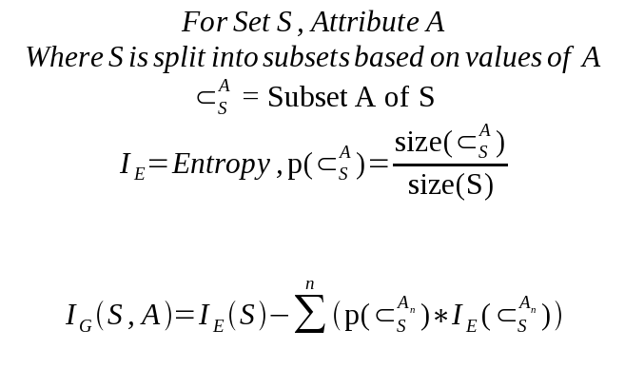
Information Gain

Slide 6

Information Gain
Information Gain for attribute A on set S is defined by taking the entropy of S and subtracting from it the summation of the entropy of each subset of S, determined by values of A, multiplied by each subset’s proportion of S.

Slide 7
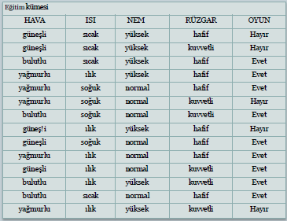
Example for ID3

Slide 8

Finding Root
OYUN = {hayır, hayır, hayır, hayır, hayır, evet, evet, evet, evet, evet, evet, evet, evet, evet}
C1, sınıfı "hayır", C2, sınıfı ise "evet“
P1=5/14, P2=9/14

Slide 9
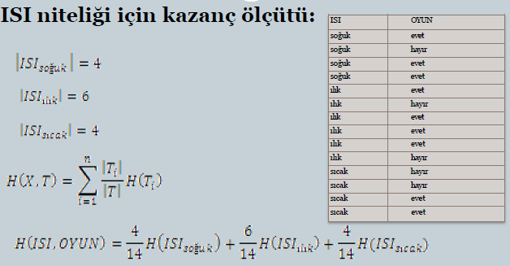
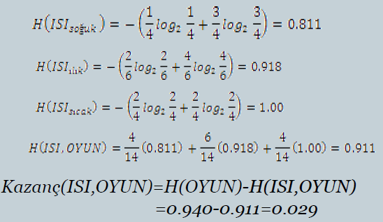
Finding Root

Slide 10
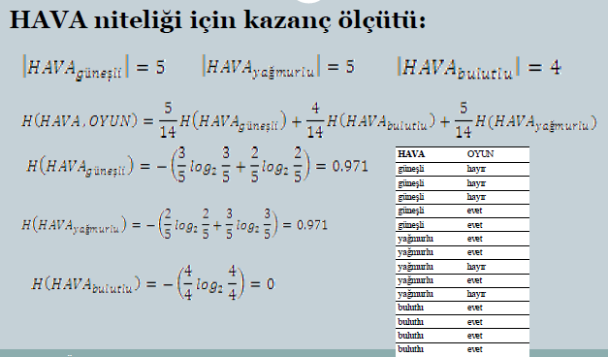
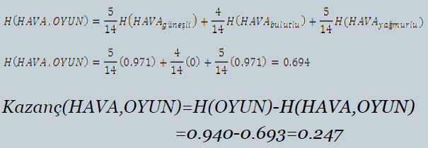
Finding Root

Slide 11
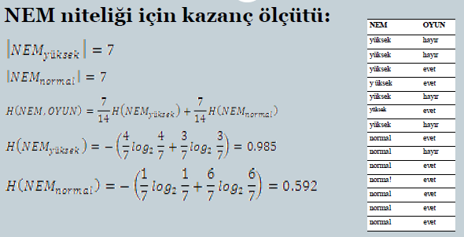
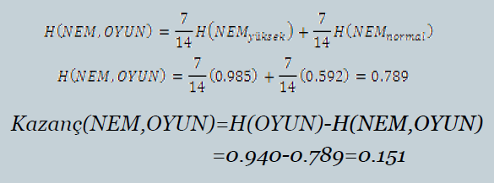
Finding Root

Slide 12
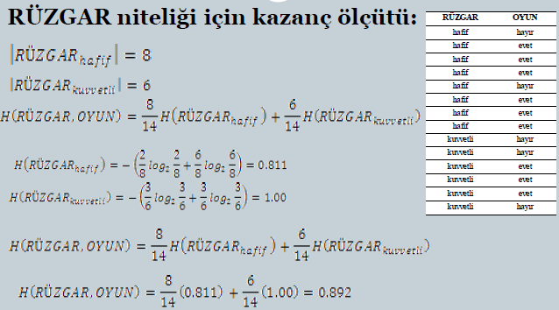
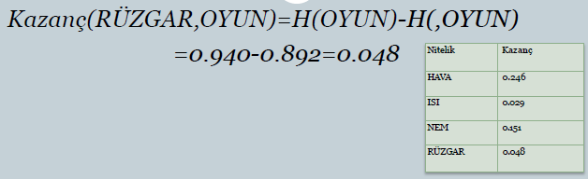
Finding Root

Slide 13
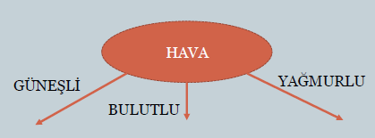
Finding Root
Birinci dallanma sonucu karar ağacı:

Slide 14
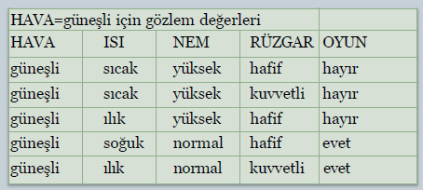
Finding Node for «Hava = güneşli»

Slide 15

Finding Node for «Hava = güneşli»
Oyun için entropi:

Slide 16
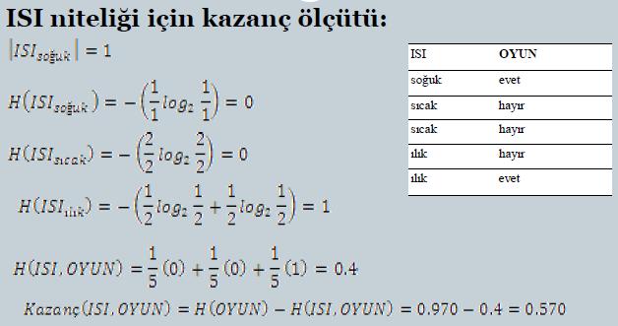
Finding Node for «Hava = güneşli»

Slide 17
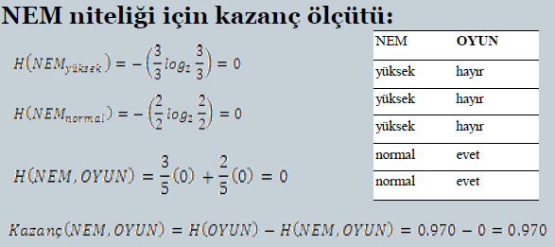
Finding Node for «Hava = güneşli»

Slide 18
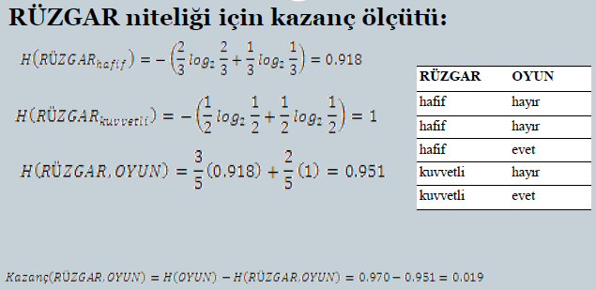
Finding Node for «Hava = güneşli»

Slide 19
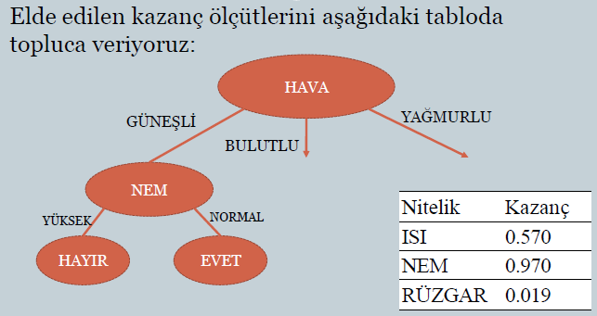
Finding Node for «Hava = güneşli»

Slide 20
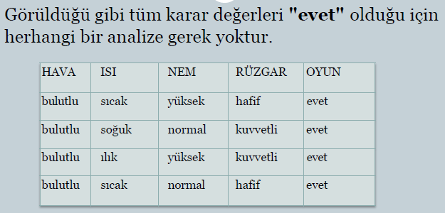
Finding Node for «Hava = bulutlu»

Slide 21
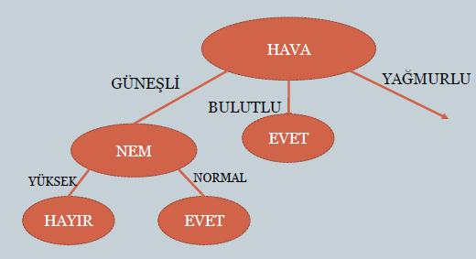
Finding Node for «Hava = bulutlu»

Slide 22
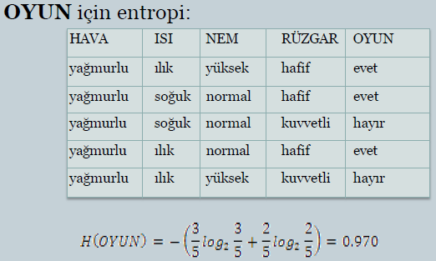
Finding Node for «Hava = yağmurlu»

Slide 23
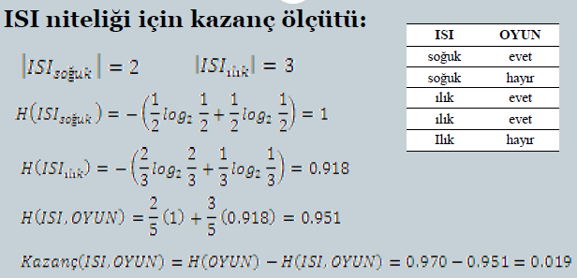
Finding Node for «Hava = yağmurlu»

Slide 24
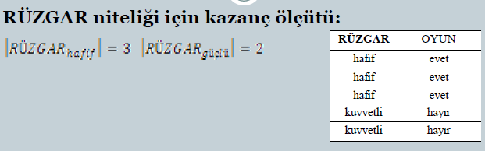
Finding Node for «Hava = yağmurlu»

Slide 25
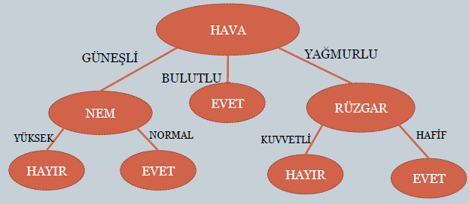
Final Decision Tree

Slide 26
Overfitting the Data: Definition
Assume a hypothesis space H. We say a hypothesis h in H overfits
a dataset D if there is another hypothesis h’ in H where h has better
classification accuracy than h’ on D but worse classification accuracy
than h’ on D’.
training data
overfitting
0.5 0.6 0.7 0.8 0.9 1.0
testing data
Size of the tree
Notes:
What is machine learning?

Slide 27
Causes for Overfitting the Data
What causes a hypothesis to overfit the data?
Random errors or noise
Examples have incorrect class label or
incorrect attribute values.
Coincidental patterns
By chance examples seem to deviate from a pattern due to
the small size of the sample.
Overfitting is a serious problem that can cause
strong performance degradation.
Notes:
What is machine learning?

Slide 28
Solutions for Overfitting the Data
There are two main classes of solutions:
Stop the tree early before it begins to overfit the data.
+ In practice this solution is hard to implement because it
is not clear what is a good stopping point.
2) Grow the tree until the algorithm stops even if the overfitting
problem shows up. Then prune the tree as a post-processing
step.
+ This method has found great popularity in the machine
learning community.
Notes:
What is machine learning?

Slide 29
Decision Tree Pruning
1.) Grow the tree to learn the
training data
2.) Prune tree to avoid overfitting
the data
Notes:
What is machine learning?

Slide 30
Pruning
Goal: Prevent overfitting to noise in the data
Two strategies for “pruning” the decision tree:
Postpruning - take a fully-grown decision tree and discard unreliable parts
Prepruning - stop growing a branch when information becomes unreliable
Postpruning preferred in practice—prepruning can “stop too early”

Slide 31
Prepruning
Based on statistical significance test
Stop growing the tree when there is no statistically significant association between any attribute and the class at a particular node
Most popular test: chi-squared test
ID3 used chi-squared test in addition to information gain
Only statistically significant attributes were allowed to be selected by information gain procedure
witten & eibe

Slide 32
Early stopping
Pre-pruning may stop the growth process prematurely: early stopping
Classic example: XOR/Parity-problem
No individual attribute exhibits any significant association to the class
Structure is only visible in fully expanded tree
Pre-pruning won’t expand the root node
But: XOR-type problems rare in practice
And: pre-pruning faster than post-pruning
 | a | b | class
1 | 0 | 0 | 0
2 | 0 | 1 | 1
3 | 1 | 0 | 1
4 | 1 | 1 | 0
witten & eibe

Slide 33
Post-pruning
First, build full tree
Then, prune it
Fully-grown tree shows all attribute interactions
Problem: some subtrees might be due to chance effects
Two pruning operations:
Subtree replacement
Subtree raising
Possible strategies:
error estimation
significance testing
MDL principle
witten & eibe

Slide 34
C4.5
ID3, CHAID – 1960s
C4.5 innovations (Quinlan):
permit numeric attributes
deal sensibly with missing values
pruning to deal with for noisy data
C4.5 - one of best-known and most widely-used learning algorithms
Last research version: C4.8, implemented in Weka as J4.8 (Java)
Commercial successor: C5.0 (available from Rulequest)

Slide 35
Numeric attributes
Standard method: binary splits
E.g. temp < 45
Unlike nominal attributes, every attribute has many possible split points
Solution is straightforward extension:
Evaluate info gain (or other measure) for every possible split point of attribute
Choose “best” split point
Info gain for best split point is info gain for attribute
Computationally more demanding
witten & eibe

Slide 36
Weather data – nominal values
Outlook | Temperature | Humidity | Windy | Play
Sunny | Hot | High | False | No
Sunny | Hot | High | True | No
Overcast | Hot | High | False | Yes
Rainy | Mild | Normal | False | Yes
… | … | … | … | …
If outlook = sunny and humidity = high then play = no If outlook = rainy and windy = true then play = no If outlook = overcast then play = yes If humidity = normal then play = yes If none of the above then play = yes
witten & eibe

Slide 37
Weather data - numeric
Outlook | Temperature | Humidity | Windy | Play
Sunny | 85 | 85 | False | No
Sunny | 80 | 90 | True | No
Overcast | 83 | 86 | False | Yes
Rainy | 75 | 80 | False | Yes
… | … | … | … | …
If outlook = sunny and humidity > 83 then play = no If outlook = rainy and windy = true then play = no If outlook = overcast then play = yes If humidity < 85 then play = yes If none of the above then play = yes

Slide 38
Example
Split on temperature attribute:
E.g. temperature < 71.5: yes/4, no/2 temperature ≥ 71.5: yes/5, no/3
Info([4,2],[5,3]) = 6/14 info([4,2]) + 8/14 info([5,3]) = 0.939 bits
Place split points halfway between values
Can evaluate all split points in one pass!
64 65 68 69 70 71 72 72 75 75 80 81 83 85 Yes No Yes Yes Yes No No Yes Yes Yes No Yes Yes No
witten & eibe

Slide 39
Avoid repeated sorting!
Sort instances by the values of the numeric attribute
Time complexity for sorting: O (n log n)
Q. Does this have to be repeated at each node of the tree?
A: No! Sort order for children can be derived from sort order for parent
Time complexity of derivation: O (n)
Drawback: need to create and store an array of sorted indices for each numeric attribute
witten & eibe

Slide 40
More speeding up
Entropy only needs to be evaluated between points of different classes (Fayyad & Irani, 1992)
value
class
64 65 68 69 70 71 72 72 75 75 80 81 83 85 Yes No Yes Yes Yes No No Yes Yes Yes No Yes Yes No
X
Potential optimal breakpoints
Breakpoints between values of the same class cannot
be optimal

Slide 41
Binary vs. multi-way splits
Splitting (multi-way) on a nominal attribute exhausts all information in that attribute
Nominal attribute is tested (at most) once on any path in the tree
Not so for binary splits on numeric attributes!
Numeric attribute may be tested several times along a path in the tree
Disadvantage: tree is hard to read
Remedy:
pre-discretize numeric attributes, or
use multi-way splits instead of binary ones
witten & eibe

Slide 42
Missing as a separate value
Missing value denoted “?” in C4.X
Simple idea: treat missing as a separate value
Q: When this is not appropriate?
A: When values are missing due to different reasons
Example 1: gene expression could be missing when it is very high or very low
Example 2: field IsPregnant=missing for a male patient should be treated differently (no) than for a female patient of age 25 (unknown)

Slide 43
Missing values - advanced
Split instances with missing values into pieces
A piece going down a branch receives a weight proportional to the popularity of the branch
weights sum to 1
Info gain works with fractional instances
use sums of weights instead of counts
During classification, split the instance into pieces in the same way
Merge probability distribution using weights
witten & eibe

